Slide 1
Red Hen Audio Tagger
Presented by - Aayush Jannumahanti
GSOC’23 Student Contributor

Slide 2
Project Problem Statement: Tag Events and transcribe using E2E ASR in 1-shot
Design a system to automatically transcribe and tag events in audio/video segments. This involves video cropping, file retrieval from a remote server, transcription into text, event tagging, packaging into JSON format, and fine-tuning an existing end-to-end Automatic Speech Recognition (E2E ASR) model for improved performance on similar tasks. The goal is to automate content analysis and make information more accessible.

Slide 3
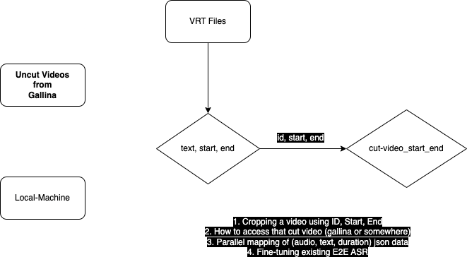
Tasks

Slide 4
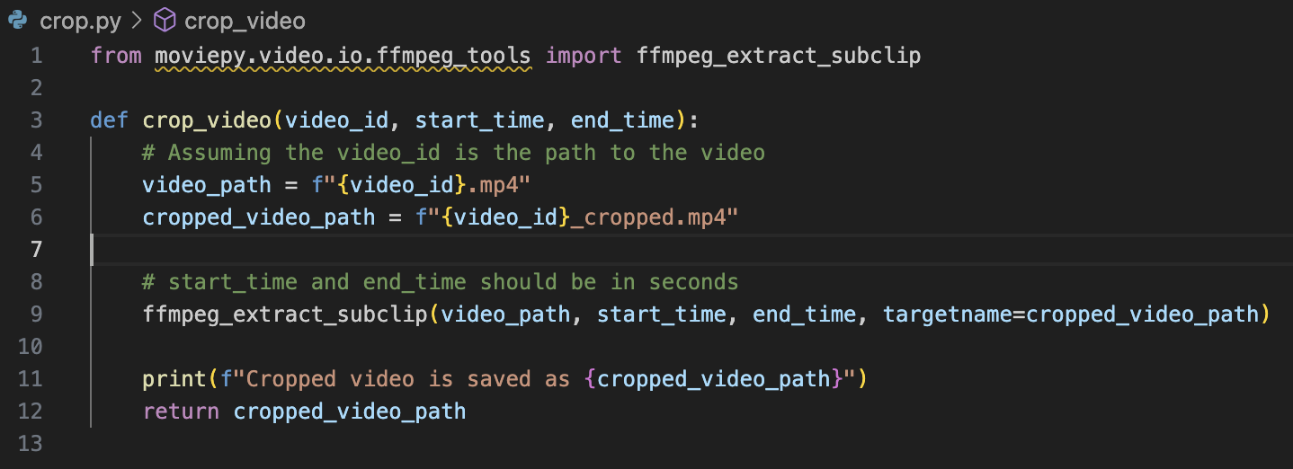
How to crop video using ID, Start and End:
In Python, using the ‘moviepy’ library. The ‘ffmpeg_extract_subclip’ function allows to specify start and end time. The first step is to identify the video to b worked with (ID or path), start, end times for the section to be cropped.

Slide 5
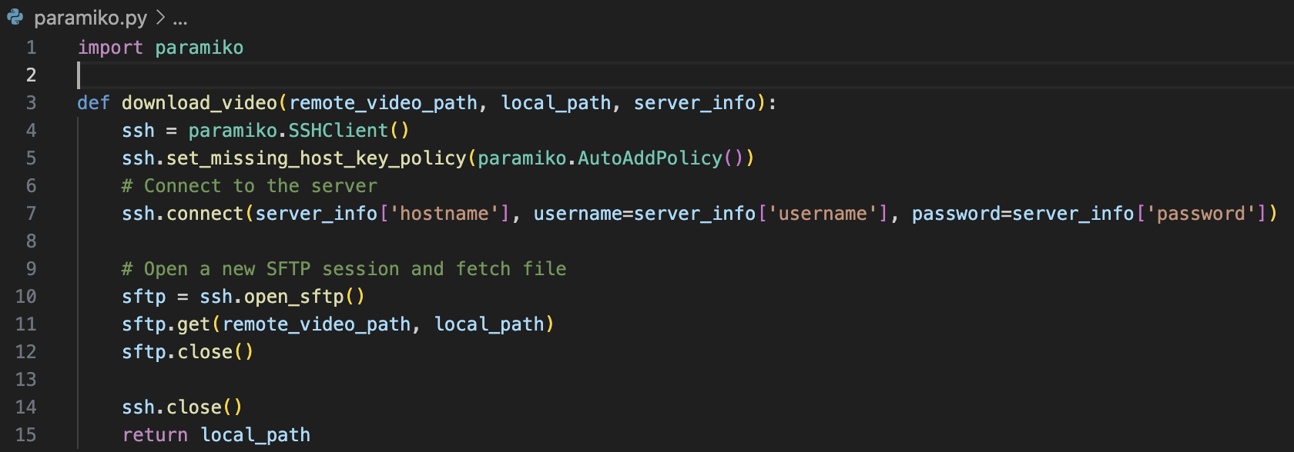
2. How to access the cut videos from Gallina Server
Method to access files from remote server using (SSH) protocol in python is using ‘paramiko’ library for SSH communications

Slide 6
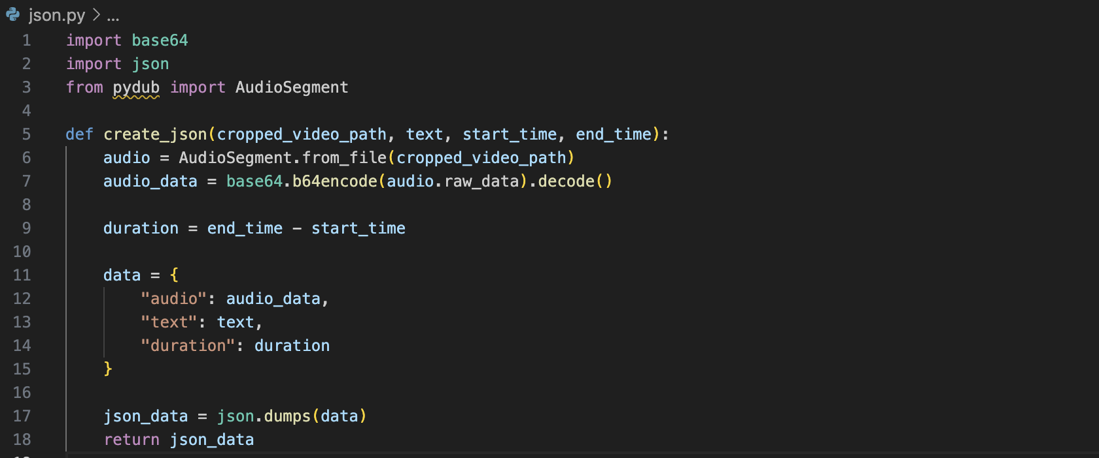
3. The JSON data contains parallel mappings of (audio, text, duration)
To achieve this converting the audio to a suitable format for JSON like base64, extracting audio from video libraries like ‘moviepy’ or ‘pydub’. For duration - a script to calc difference among start and end times.

Slide 7
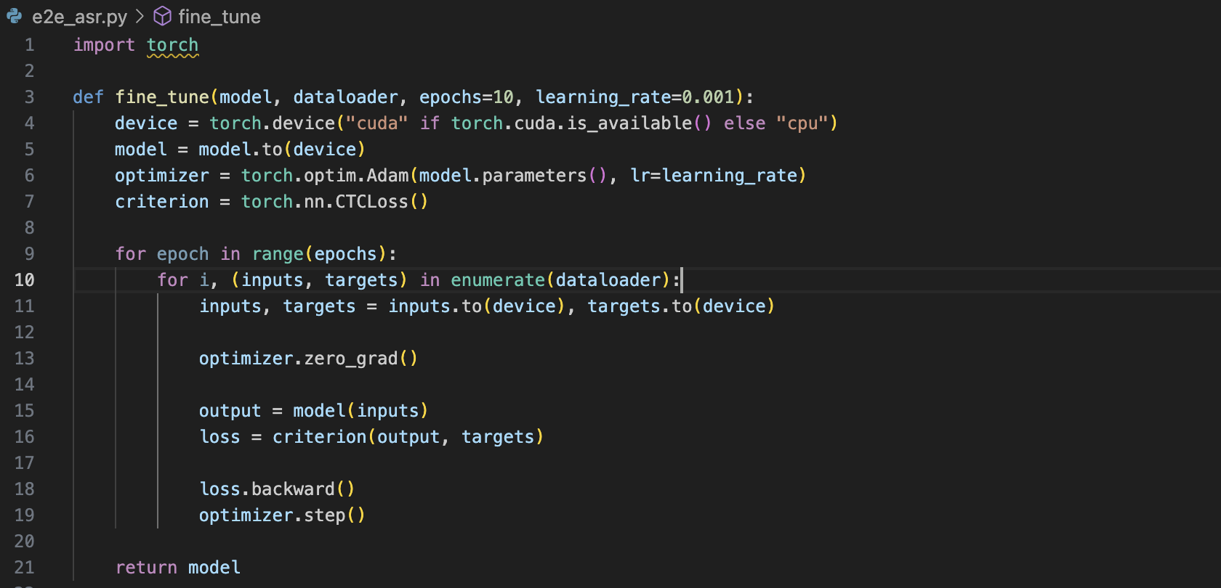
4. Fine-tuning an existing E2E ASR
This involves using dataset to further train an existing model. This also depend on ASR model being used and ML libraries taken into consideration. Using PyTorch an ASR is similar like this

Slide 8
Related Works
Blogging
Constant communication on Slack
Weekly sync-up with mentors

